Slide 1

Part-1: Decision Tree Classifier

Slide 2
Decision Tree
Decision tree builds regression or classification models in the form of a tree structure.
  For discrete value target functions (labels) – classification models
  For continuous value target functions (labels) – regression models
It breaks down a dataset into smaller and smaller subsets while at the same time an associated decision tree is incrementally developed.
For discrete value target functions (for classification)
  If-then-else rule
  Most widely used approach

Slide 3
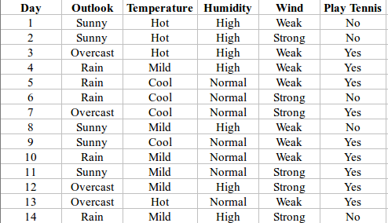
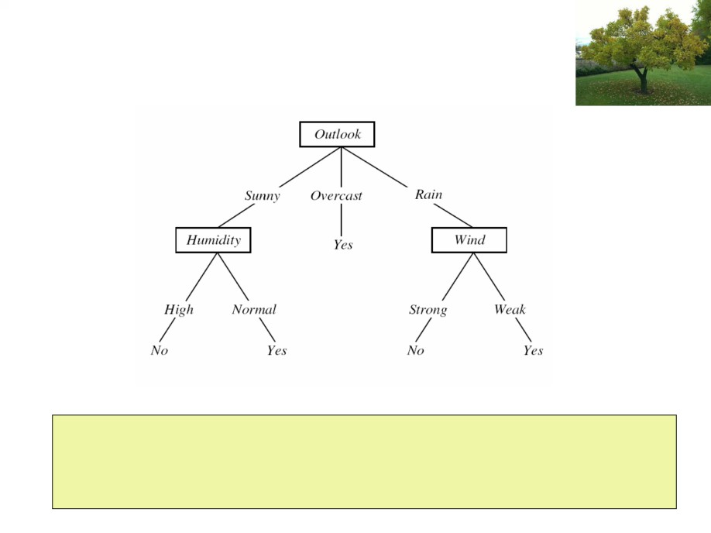
Decision Tree
Instance classification starts at the root node of the tree
Testing the attribute values specified by this node
Moving down the tree branch corresponding to the value of the attribute in the given example.
This process is then repeated for the subtree rooted at the new node

Slide 4
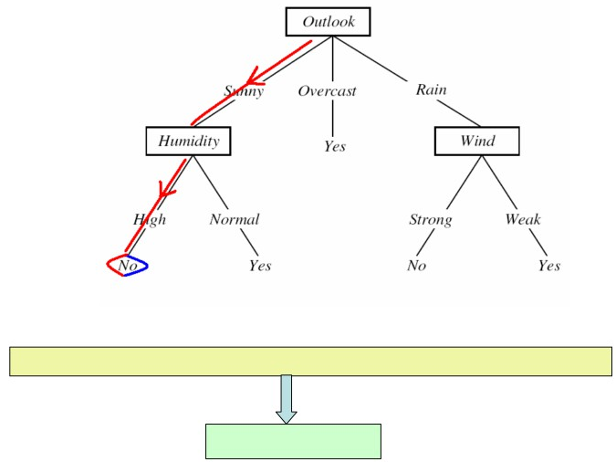
Decision Tree
<Outlook = Sunny, Temperature = Hot, Humidity = High, Wind = Strong>
PlayTennis = No

Slide 5
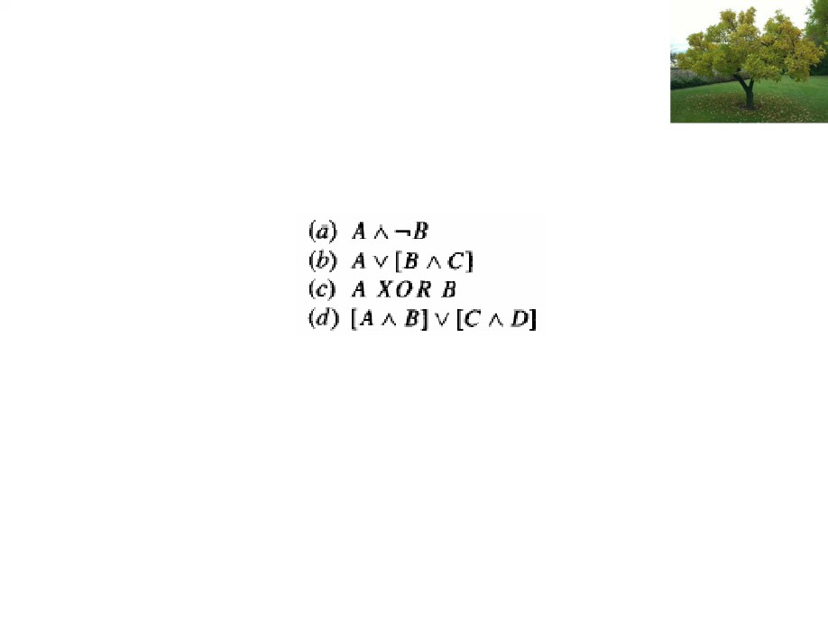
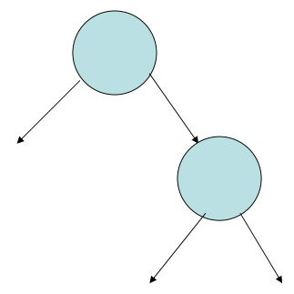
Decision Tree
Decision Trees (F = A ^ B')
If (A=True and B = False) then Yes
else
No
A
A
False
True
No
B
B
False
True
Yes
No

Slide 6
Types of Problems Suitable for Decision Tree Classifier
Instances are represented by multiple attribute values
  Temperature: (Hot, Mild, Cold)
The target function has discrete output values
Disjunctive descriptions may be required
The training data may contain errors
The training data may contain missing attribute values

Slide 7
Decision Tree Learning
ID3 Algorithm (Quinlan 1986)
Employs a top-down
An instance is classified by starting at the root node of the tree, testing the attribute specified by this node, then moving down the tree branch corresponding to the value of the attribute in the given example.
This process is then repeated for the subtree rooted at the new node. Greedy search the space of possible decision trees. The algorithm never backtracks to reconsider earlier choices.

Slide 8
ID3 Algorithm (Quinlan 1986)
ID3 uses - information gain measure to select among the candidate attributes at each step while growing the tree.
Information gain is based on information theory concept called Entropy
Entropy is a measure of the uncertainty associated with a random variable.

Slide 9
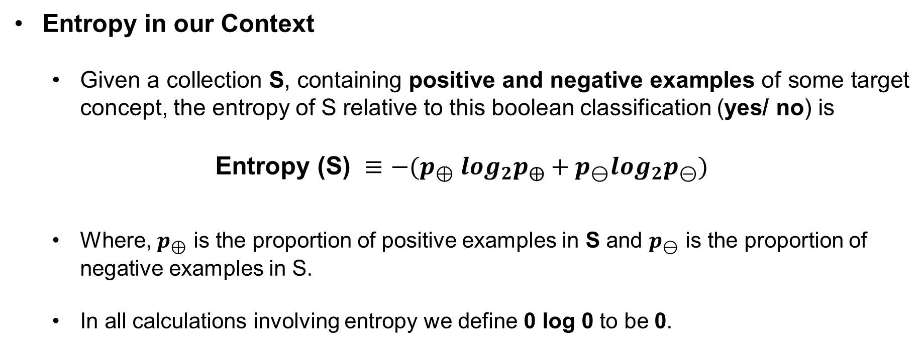
Entropy in our Context
  Given a collection S, containing positive and negative examples of some target concept, the entropy of S relative to this boolean classification (yes/ no) is
$$\text{Entropy (S) }≡{−(p}_{⊕} \log_{2}p_{⨁}+p_{⊖}\log_{2}p_{⊝})$$
  Where, $p_{⊕}$ is the proportion of positive examples in S and $p_{⊖}$ is the proportion of negative examples in S.
  In all calculations involving entropy we define 0 log 0 to be 0.

Slide 10
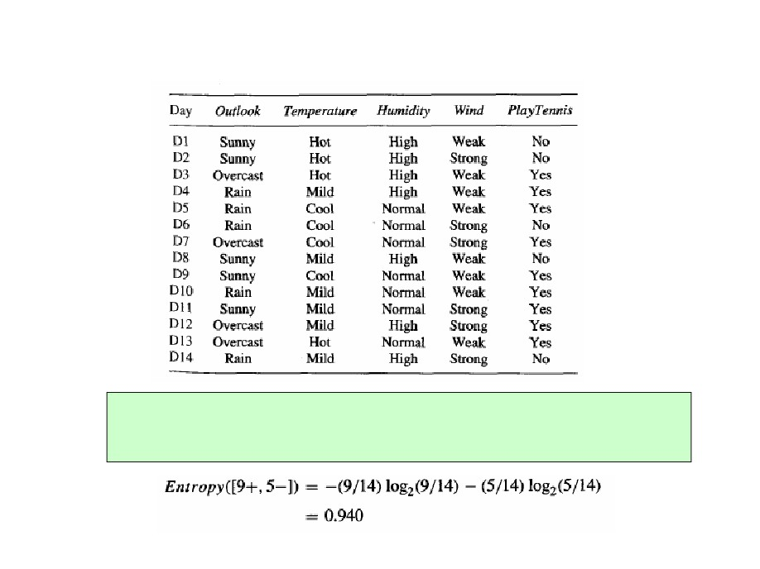
Entropy
There are 14 examples. 9 positive and 5 negative examples [9+, 5-].
The entropy of S relative to this Boolean (yes/no) classification is

Slide 11
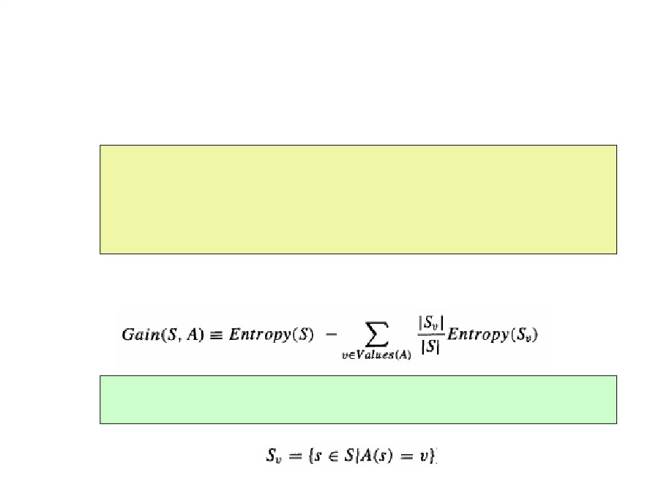
Information Gain Measure
Information gain, is simply the expected reduction in entropy caused by partitioning the examples according to this attribute.
More precisely, the information gain, Gain(S, A) of an attribute A, relative to a collection of examples S, is defined as
where Values(A) is the set of all possible values for attribute A, and Sv, is the subset of S for which attribute A has value v, i.e.,

Slide 12
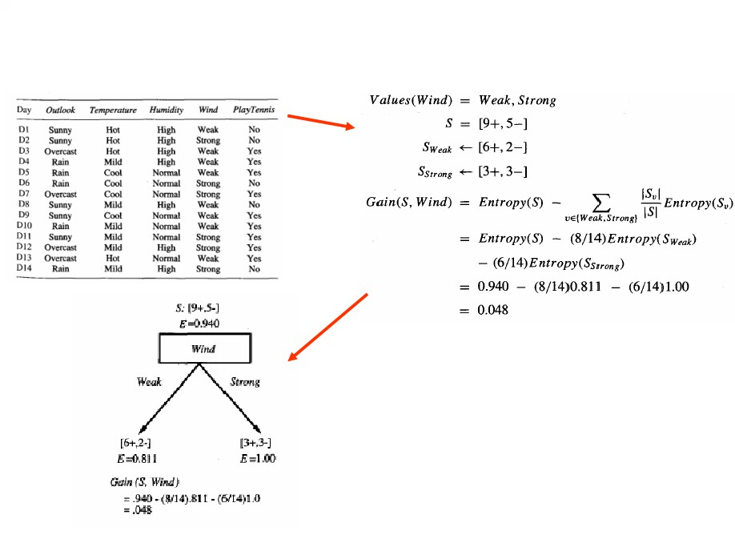
Gain (S, Attribute = Wind)

Slide 13
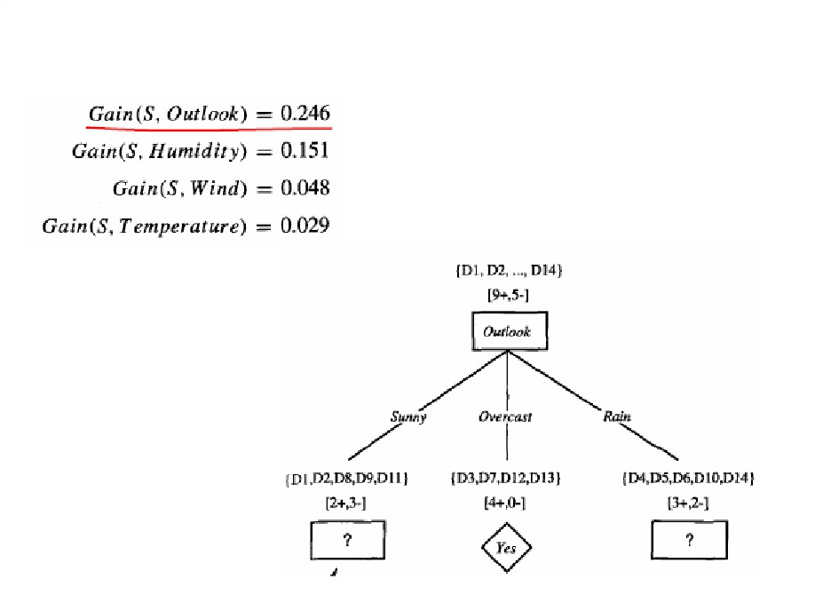
Gain (S,A)

Slide 14
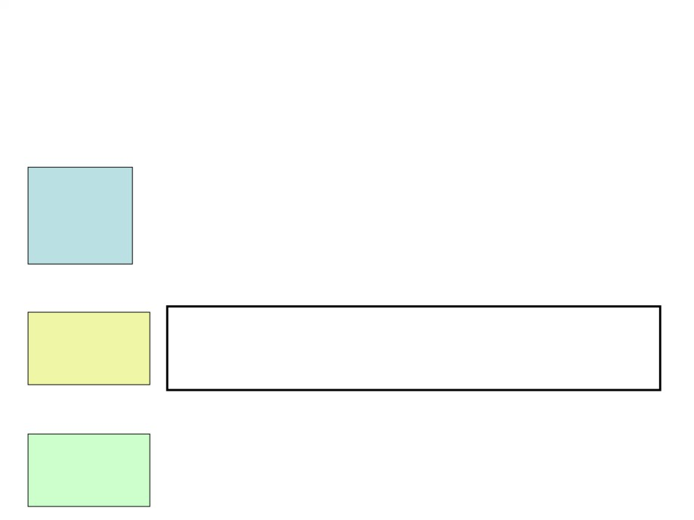
Gain (Sunny, Temperature)
Entropy(SSunny) = - { 2/5 log(2/5) + 3/5 log(3/5)} = 0.97095
Entropy(Hot) = 0
Temperature
Entropy(Mild) = 1
Entropy(Cool) = 0
(Hot) {0+, 2-)
(Mild) {1+, 1-}
(Cool) {1+, 0-}
Gain(Su, Temperature) = 0.97095 - 2/5*0 - 2/5*1 - 1/5*0 = 0.57095
Entropy(High) = 0
Entropy(Normal) = 0
Humidity
(High) {0+, 3-}
(Normal) {2+, 0-}
Gain(S1, Humidity) = 0.97095 - 3/5*0 - 2/5*0 = 0.97095
Entropy(Weak) = 0.9183
Entropy(Strong) = 1.0
Wind
(Weak) {1+, 2-}
(Strong) {1+, 1-}
Gain(S1, Wind) = 0.97095 - 3/5*0.9183 - 2/5*1 = 0.01997

Slide 15
Gain (Sunny, Humidity)
Entropy(Hot) = 0
Temperature
Entropy(Mild) = 1
Entropy(Cool) = 0
(Hot) {0+, 2-)
(Mild) {1+, 1-}
(Cool) {1+, 0-}
Gain(S1, Temperature) = 0.97095 - 2/5*0 - 2/5*1 - 1/5*0 = 0.57095
Entropy(High) = 0
Entropy(Normal) = 0
Humidity
(High) {0+, 3-}
(Normal) {2+, 0-}
Gain(Su, Humidity) = 0.97095 - 3/5*0 - 2/5*0 = 0.97095
Entropy(Weak) = 0.9183
Entropy(Strong) = 1.0
Wind
(Weak) {1+, 2-}
(Strong) {1+, 1-}
Gain(S1, Wind) = 0.97095 - 3/5*0.9183 - 2/5*1 = 0.01997

Slide 16
Gain (Sunny,A)
Entropy(Hot) = 0
Temperature
Entropy(Mild) = 1
Entropy(Cool) = 0
(Hot) {0+, 2-)
(Mild) {1+, 1-}
(Cool) {1+, 0-}
Gain(S1, Temperature) = 0.97095 - 2/5*0 - 2/5*1 - 1/5*0 = 0.57095
Entropy(High) = 0
Entropy(Normal) = 0
Humidity
(High) {0+, 3-}
(Normal) {2+, 0-}
Gain(S1, Humidity) = 0.97095 - 3/5*0 - 2/5*0 = 0.97095
Entropy(Weak) = 0.9183
Entropy(Strong) = 1.0
Wind
(Weak) {1+, 2-}
(Strong) {1+, 1-}
Gain(S1, Wind) = 0.97095 - 3/5*0.9183 - 2/5*1 = 0.01997

Slide 17
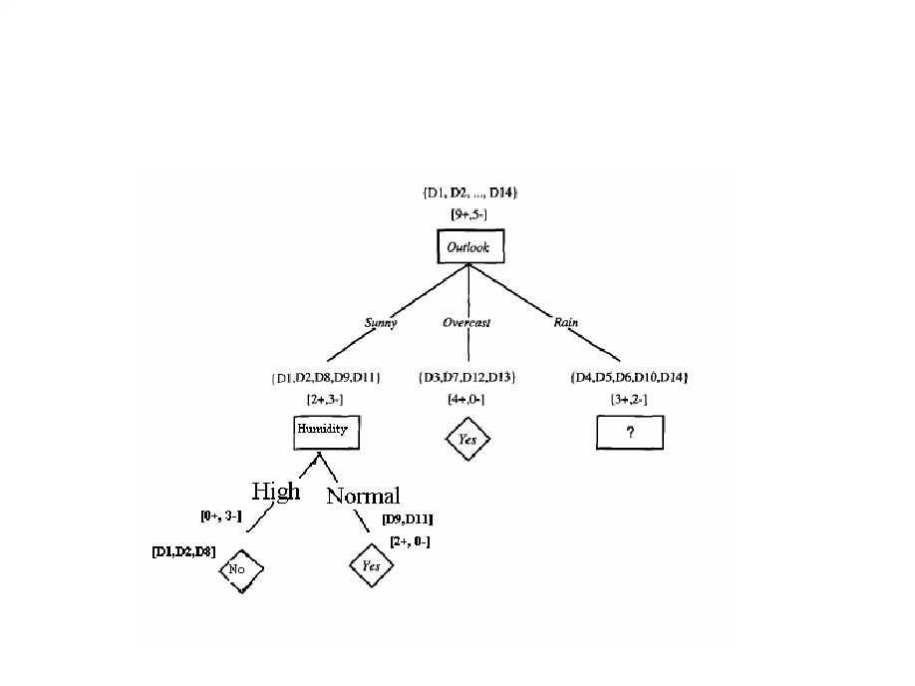
Modified Decision Tree

Slide 18
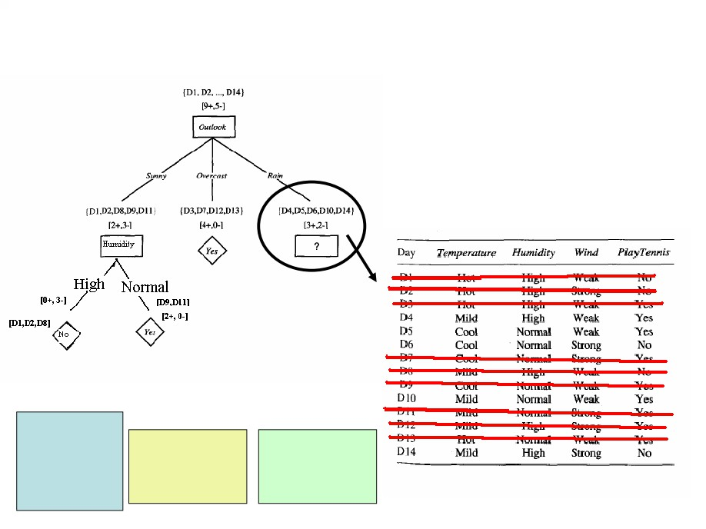
Gain (SRain, A)
Temperature
(Mild) {2+, 1-}
(Cool) {1+, 1-}
Humidity Wind
(High) {1+, 1-} (Weak) {3+, 0-}
(Normal) {2+, 1-} (Strong) {0+, 2-}

Slide 19
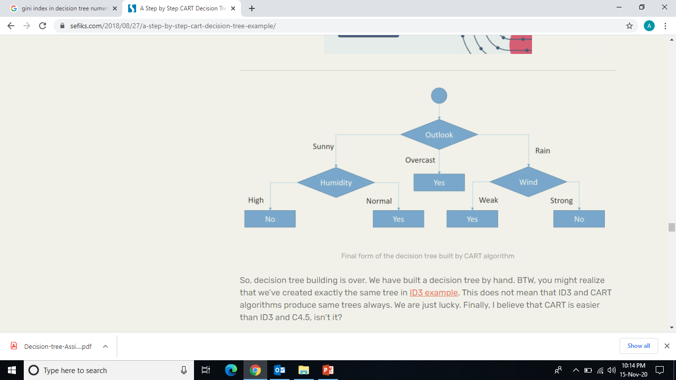
Final Decision Tree
Whether Jon will play tennis or not on D15?
OL Temp Hum Wind
D15 Rain Mild High Weak ?

Slide 20
Assignment:
Obtain DT for the following data
Instance | Attribute_1 | Attribute_2 | Class
1 | T | T | +
2 | T | T | +
3 | T | F | -
4 | F | F | +
5 | F | T | -
6 | F | T | -

Slide 21
Capabilities and Limitations of ID3 Algorithm
Advantage:
ID3 algorithm searches complete hypothesis space
ID3 uses all training examples at each step in the search.
The resulting search is much less sensitive to errors in individual training examples.

Slide 22
Capabilities and Limitations of ID3 Algorithm
Disadvantage:
  ID3 maintain only a single current hypothesis as it searches through the space of decision trees. Loses the capabilities of representing all consistent hypothesis.
  ID3 performs no backtracking in its search.
    Once it selects an attribute to test at a particular level in the tree, it never backtracks to reconsider this choice.
    Therefore, converging to locally optimal solutions that are not globally optimal.

Slide 23
Thank you

